Slide 1

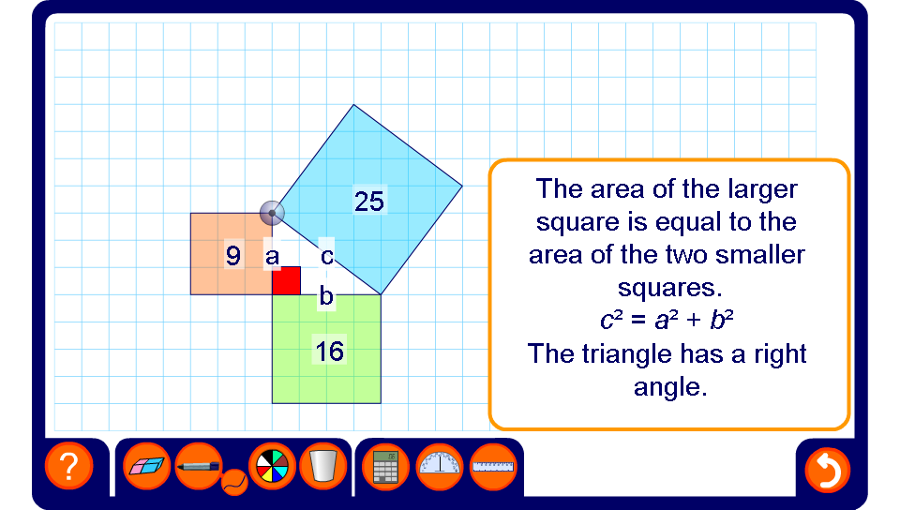


Identifying right-angled triangles
Notes:
Use this activity to demonstrate how the relationship between the sum of the squares on the two shorter sides and the square on the hypotenuse changes as the right angle is modified.
If the right angle becomes obtuse, c² gets bigger. If the right-angle becomes acute, c² gets smaller.
We can use this to decide whether a non-right-angled triangle has three acute angles or whether it contains an obtuse angle.
Ask pupils to explain why it is impossible for a triangle to contain more than one obtuse angle.

